Slide 1


TAXI SERVICES CIS 5200
Group 3
Himani Batra
Katia Kermoyan
Nishant Shristiraj
Srihitha Reddy Sivannagari

Slide 2
BACKGROUND
A group of entrepreneurs interested in starting a new transportation services company.
Our belief: The increase in population and traffic has also increased the usage of taxis in metropolitan cities like Chicago and New York.

Slide 3
GOAL
Study current transportation services in Chicago and New York to understand the market and build a business model.

Slide 4
Main Objective
Study data about existing services and derive meaningful insights and relationships between the extent of taxis used in Chicago and New York
Major Insights
Companies doing successful business
Communities where most number of rides were requested
Taxis doing the most business
Busiest hour of the day

Slide 5
H/W EXPERIMENTAL SPECIFICATIONS
Version: IOP 4.2
Number of Nodes: 1 DATA NODE
Memory Size: 24 GB RAM
Number of CPUs: 4 VCPU
DATA DISK: 1TB SATA
Number of Nodes: 1 MANAGEMENT NODE
Memory Size: 48 GB RAM
Number of CPU: 12 VCPU

Slide 6
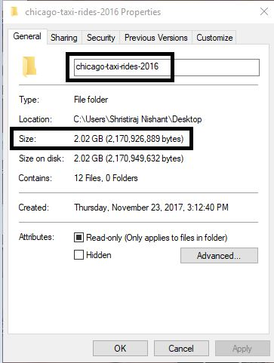
SPECIFICATIONS OF DATA SET
Data Set 1:
https://www.kaggle.com/chicago/chicago-taxi-rides-2016
Data set size: 2.02 GB

Slide 7
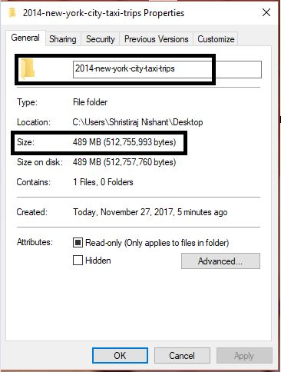
SPECIFICATIONS OF DATA SET
Data Set2:
https://www.kaggle.com/kentonnlp/2014-new-york-city-taxi-trips
Data set size: 489 MB

Slide 8







TOOLS USED

Slide 9
FLOWCHART OF DATA ANALYSIS
9
Download 2 data Sets from Kaggle.com
Create Visuals using Tableau and Excel
Predictive Analysis
Using
Azure ML
Upload datasets into HDFS
Create External tables in Hive
Queried data in Hive and Pig

Slide 10
INSIGHTS
Which companies have the highest earnings in Chicago in 2016?
Which taxi-ids generate the highest fare with the respective number of rides?
What is the total monthly comparison between Credit and Cash payments?
What is the total number of monthly pick-ups in Chicago(2016)?
Which community of Chicago has the maximum miles travelled by taxi in 2016?

Slide 11
INSIGHTS
Which communities in Chicago have the highest demand for pick-ups and Drop-offs?
Which hour of the day and which day of the month has most pickups in New York?
What are the regions with highest demand and longest distance travelled in New York?
Which is the highest earning vendor in New York?

Slide 12
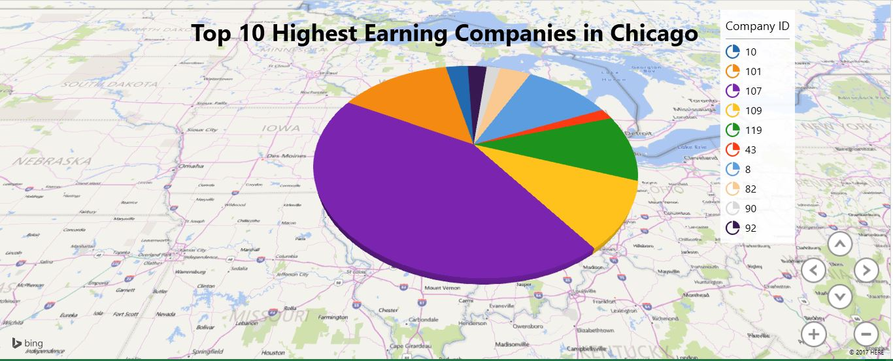
Which companies have the highest earnings in Chicago in 2016?

Slide 13
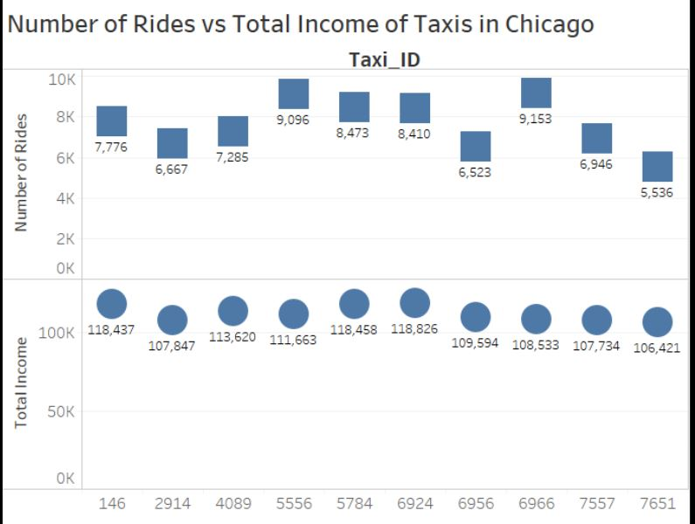
Which taxi-ids generate the highest fare with the respective number of rides?

Slide 14
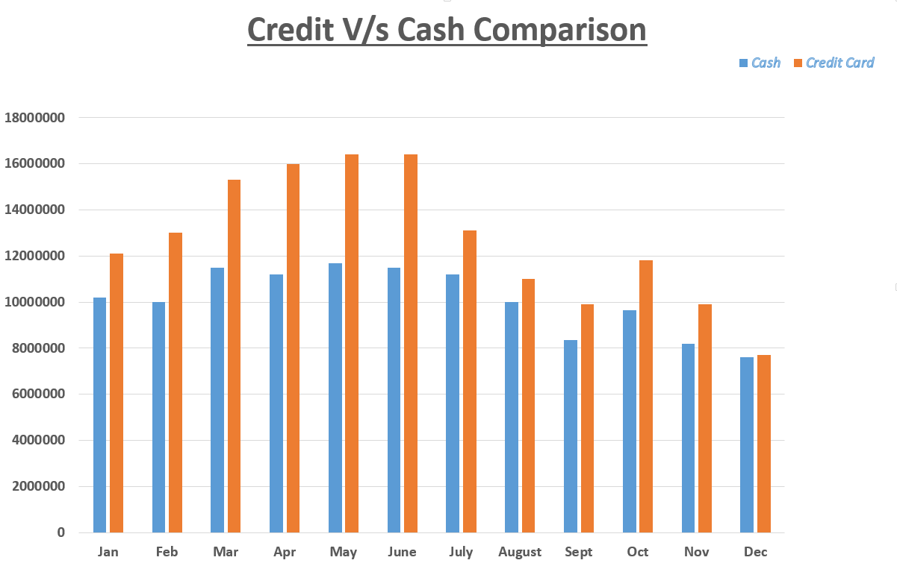
What is the total monthly comparison between Credit and Cash payment?

Slide 15
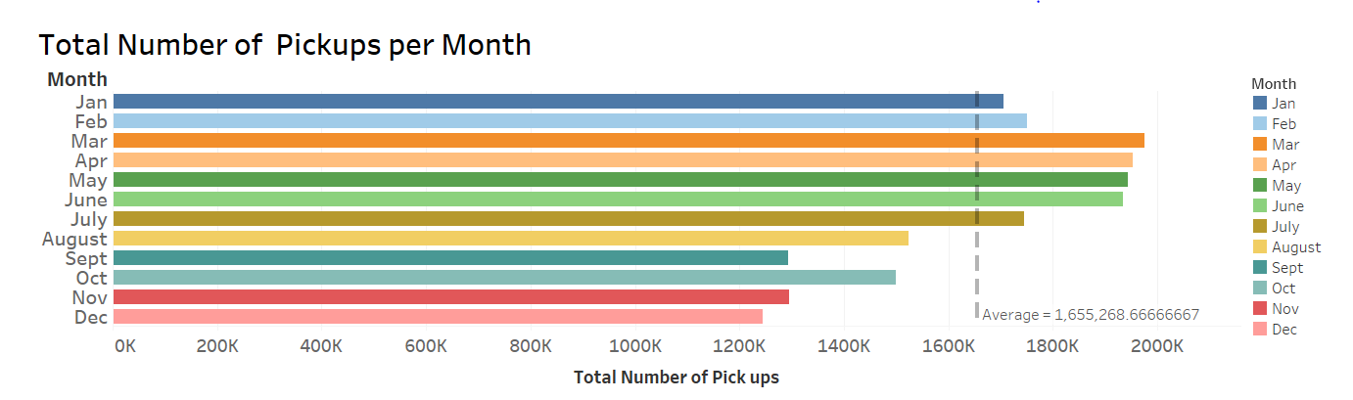
What is the total number of monthly pick-ups in Chicago(2016)?

Slide 16
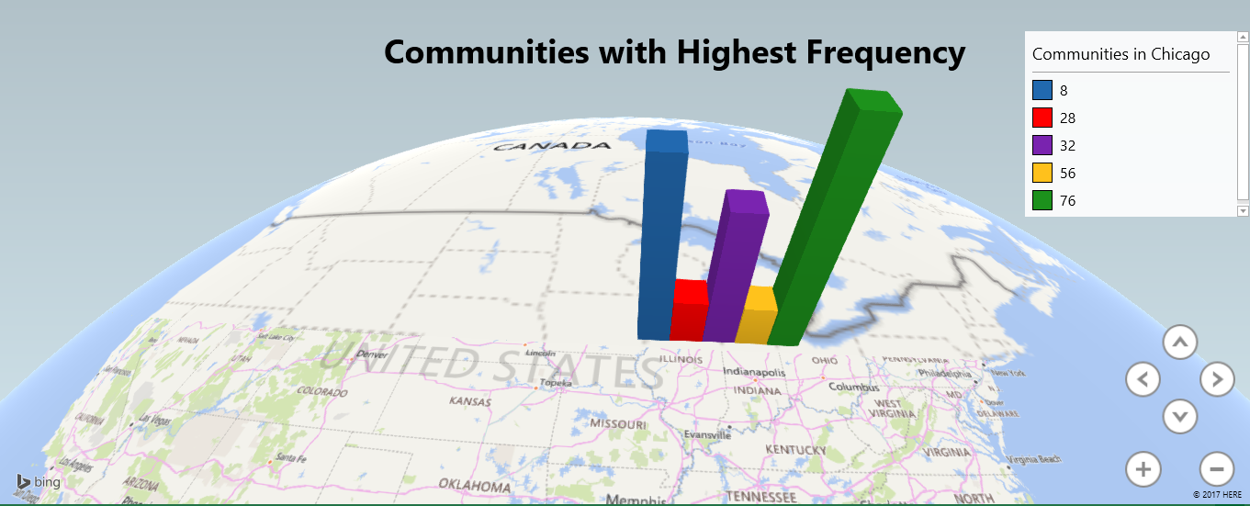
Which community of Chicago has the maximum miles travelled by taxi in 2016?

Slide 17
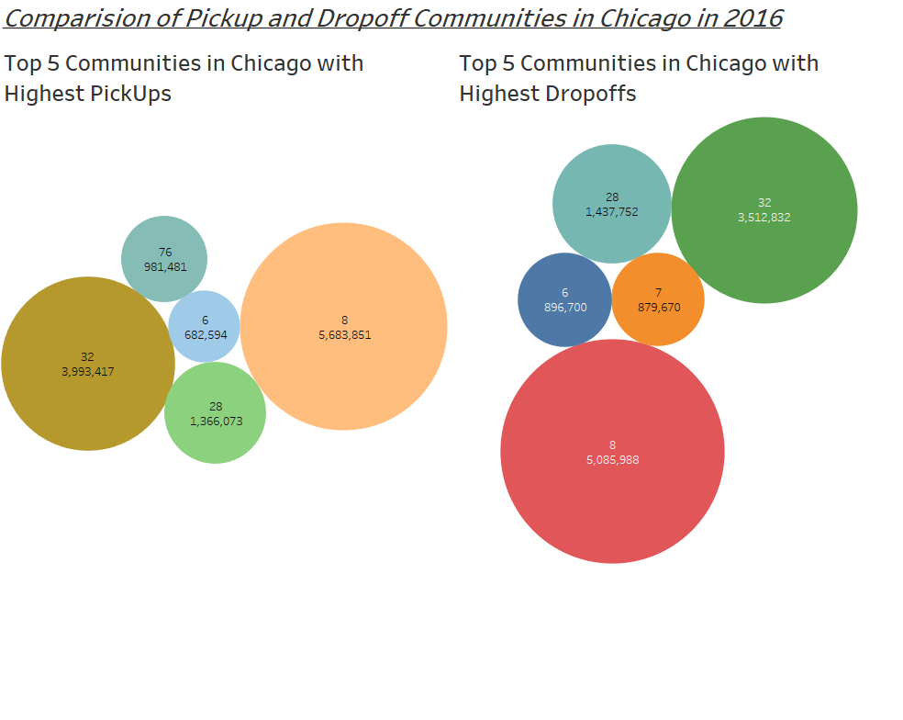
Which communities in Chicago have the highest demand for pick-ups and Drop-offs?

Slide 18
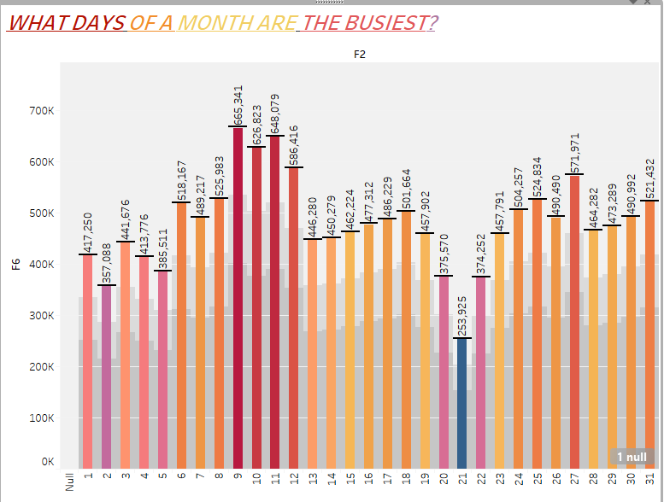
Which hour of the day and which day of the month has most pickups in New York?

Slide 19
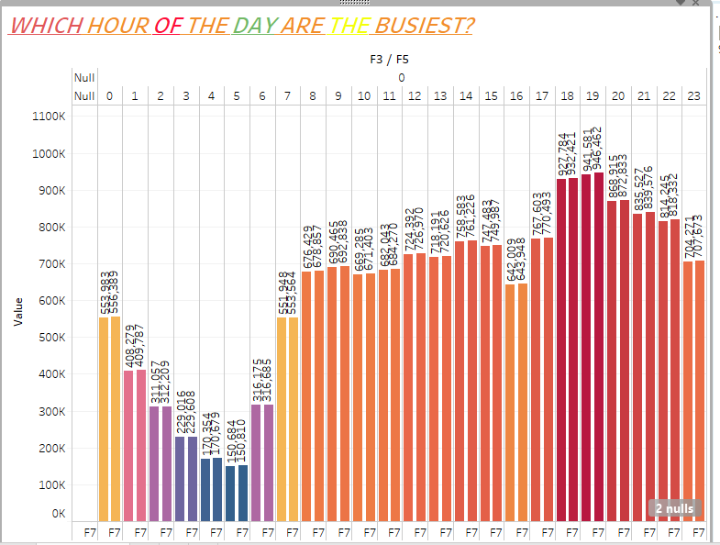

Slide 20
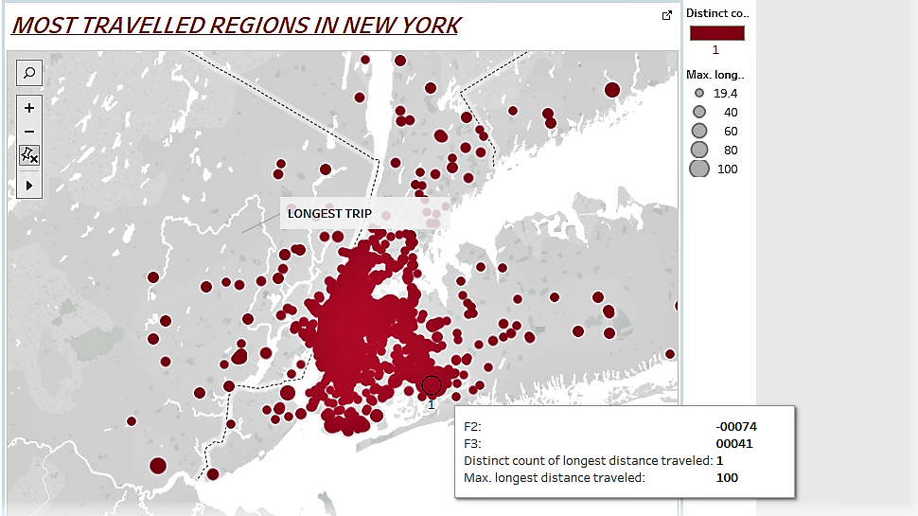
Which are the regions with highest demand and longest distance travelled in New York?

Slide 21
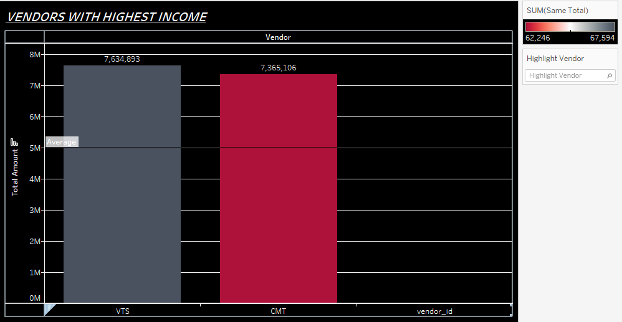
Which is the highest earning vendor in New York?

Slide 22
PREDICTIVE ANALYSIS
WITH AZURE ML

Slide 23
LINEAR REGRESSION MODEL FOR NEW YORK DATA SET
WITH AZURE ML

Slide 24
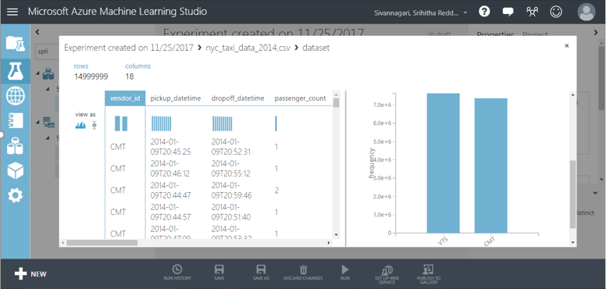
VISUALIZING NEW YORK DATA IN AZURE ML

Slide 25
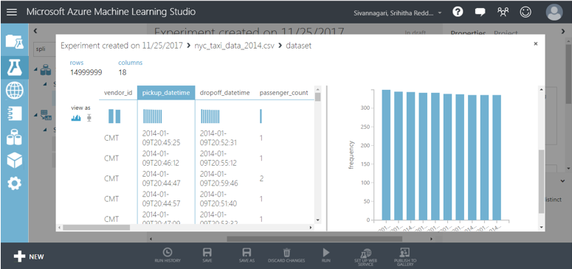

Slide 26
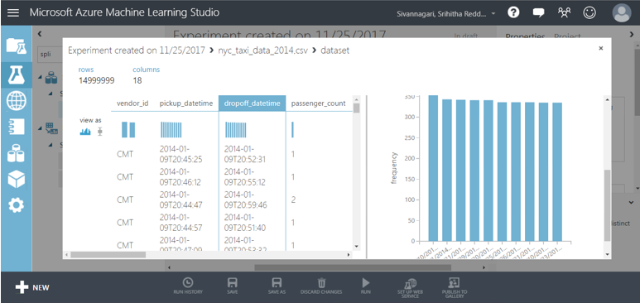

Slide 27
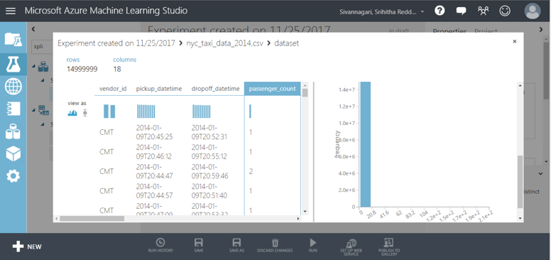

Slide 28
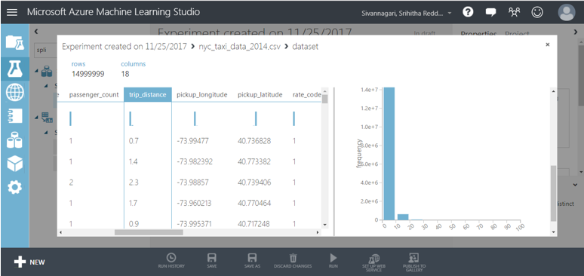

Slide 29
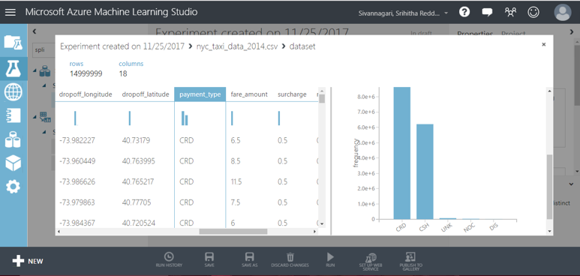

Slide 30
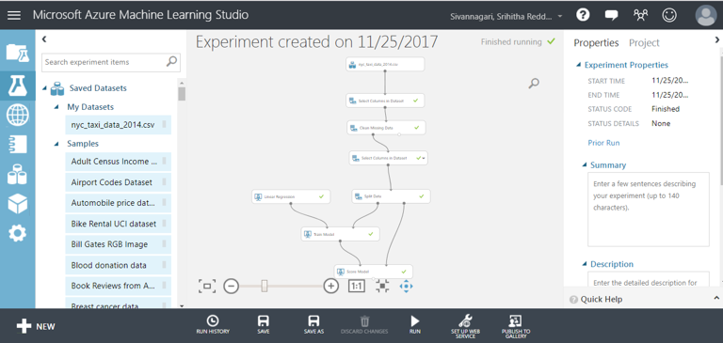

Slide 31
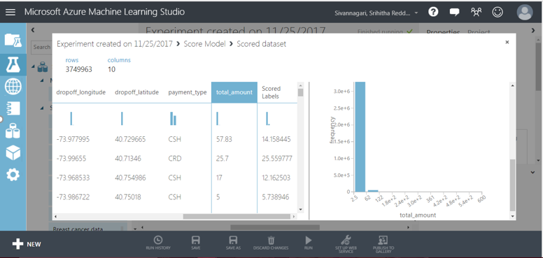
SCORED LABLE – PREDICTED TOTAL_AMOUNT

Slide 32
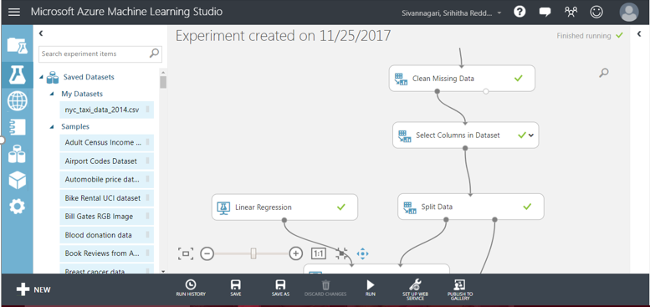

Slide 33
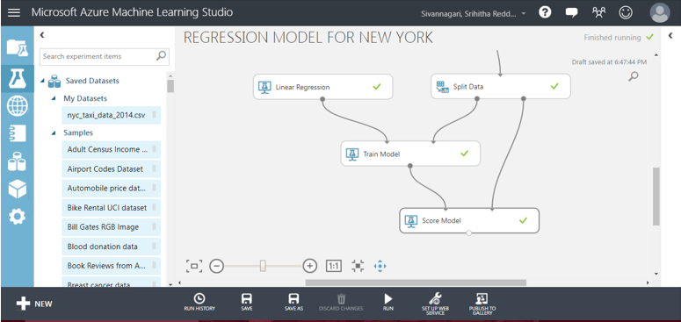

Slide 34
LINEAR REGREGRESSION MODEL FOR CHICAGO DATASET
WITH AZURE ML

Slide 35
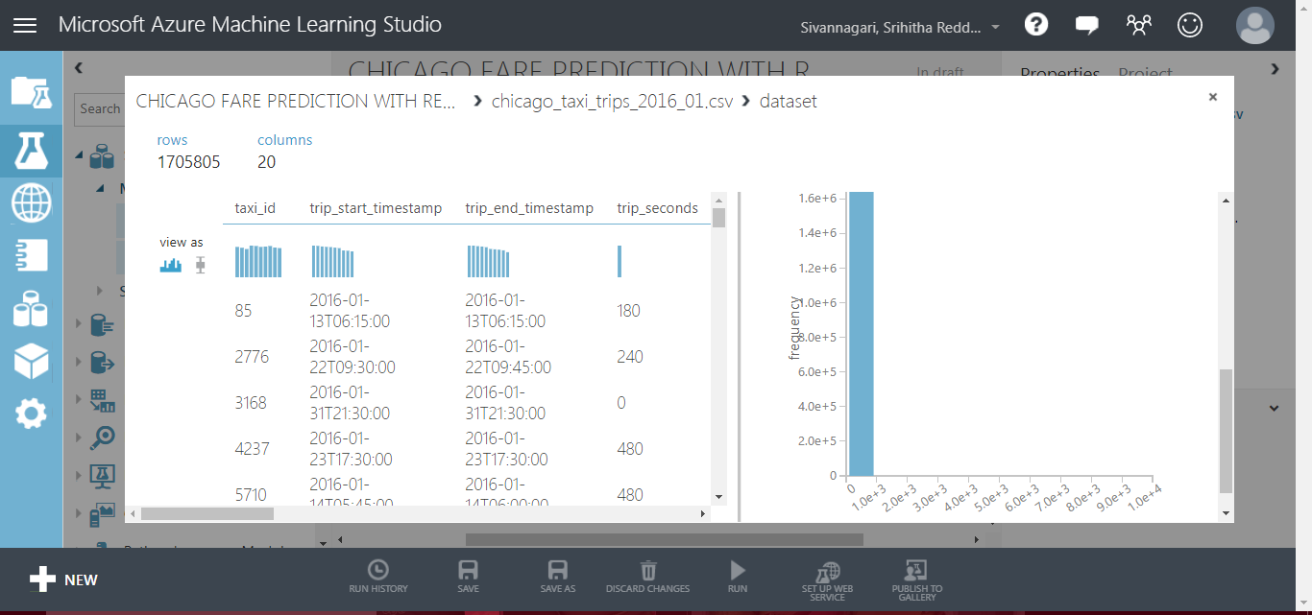
VISUALIZING NEW YORK DATASET IN AZURE ML

Slide 36
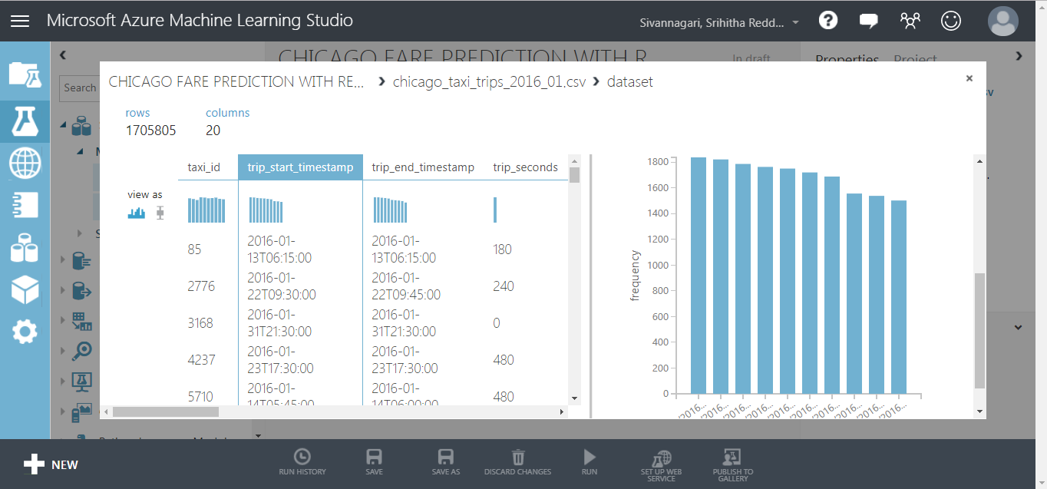

Slide 37
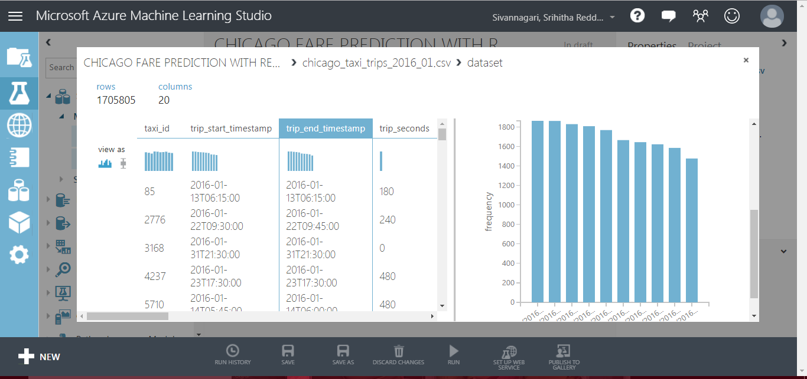

Slide 38
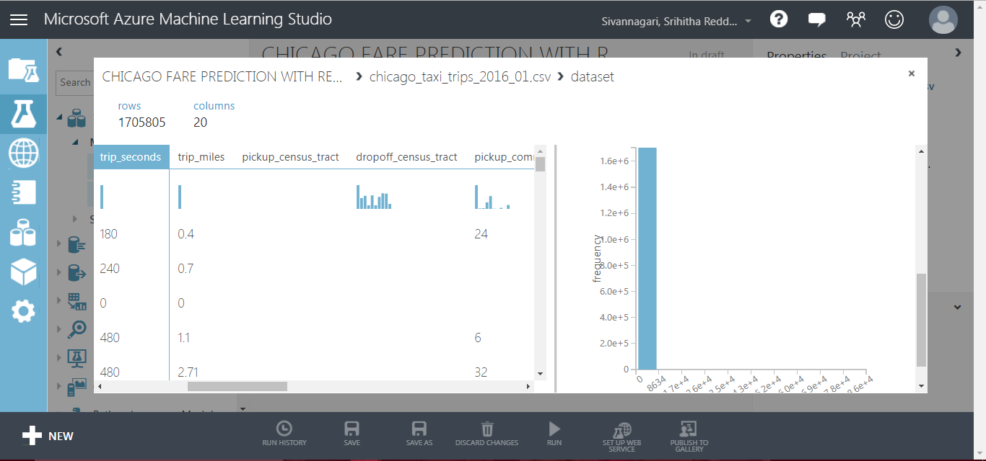

Slide 39
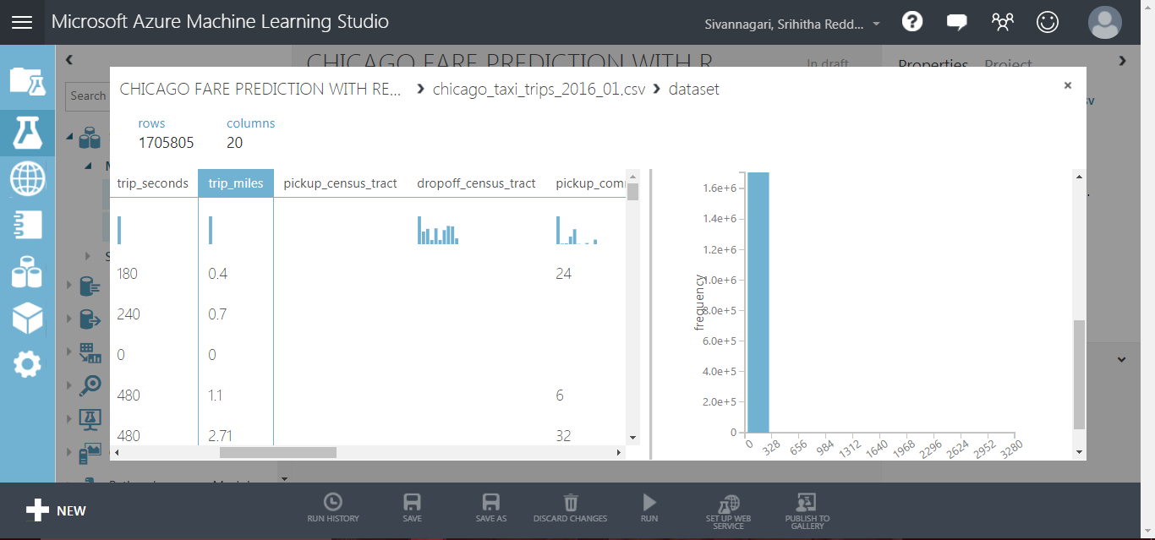

Slide 40
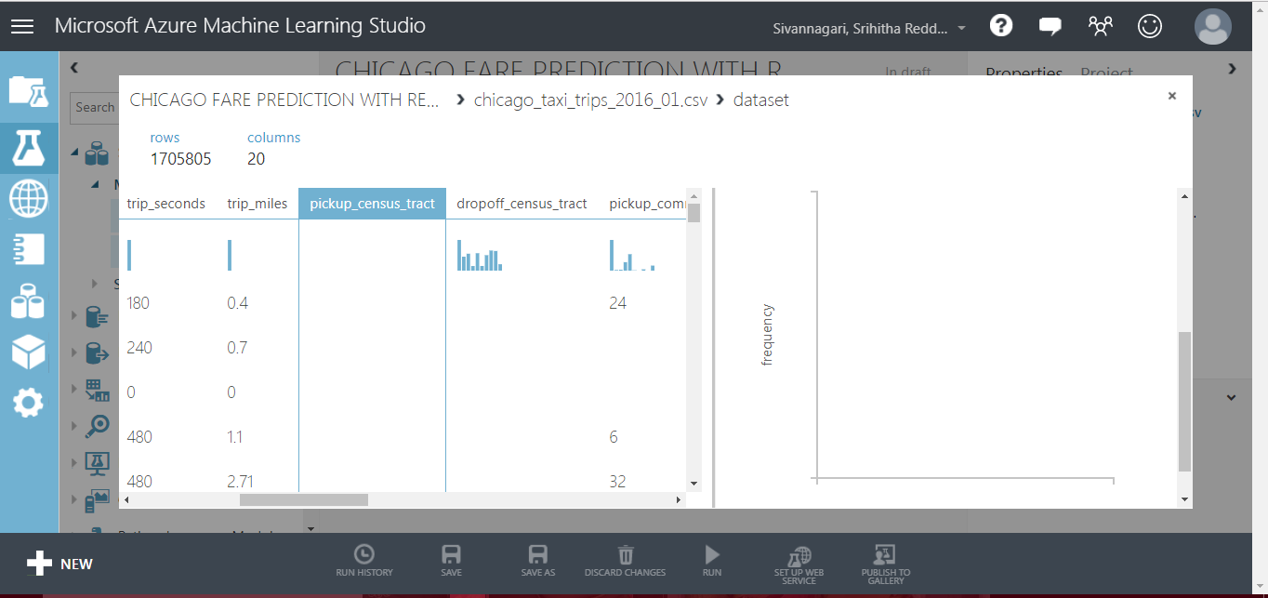

Slide 41
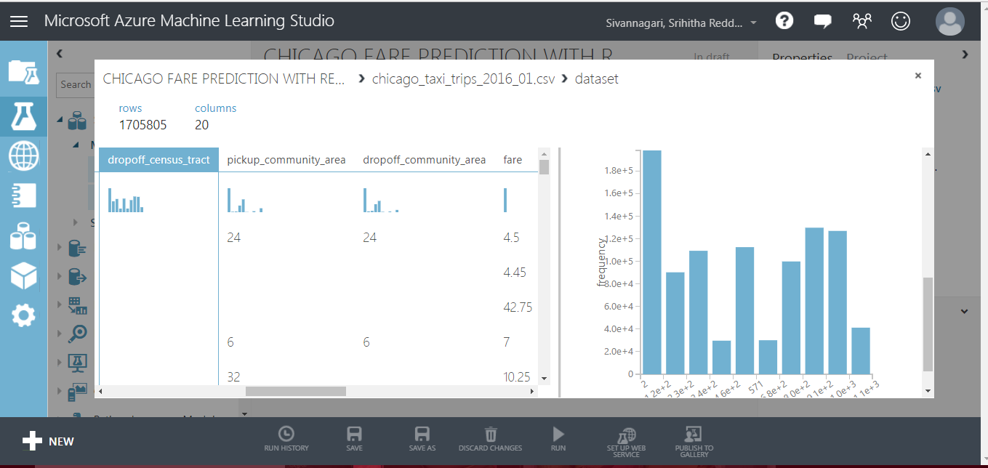

Slide 42
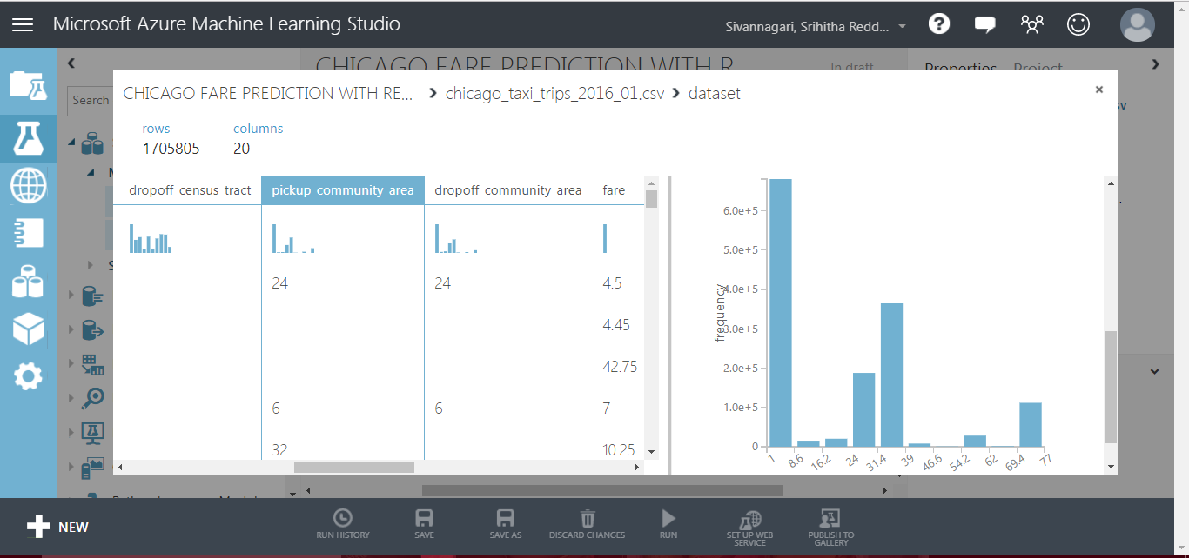

Slide 43
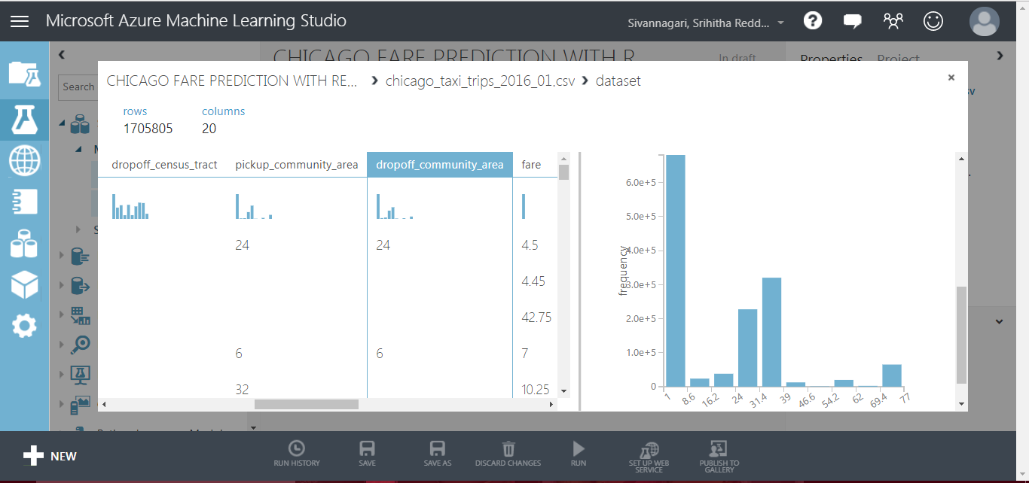

Slide 44
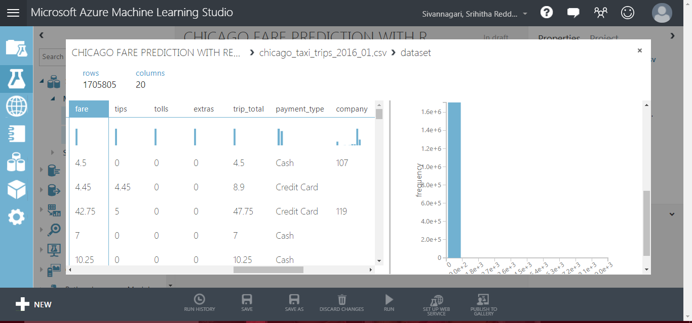

Slide 45
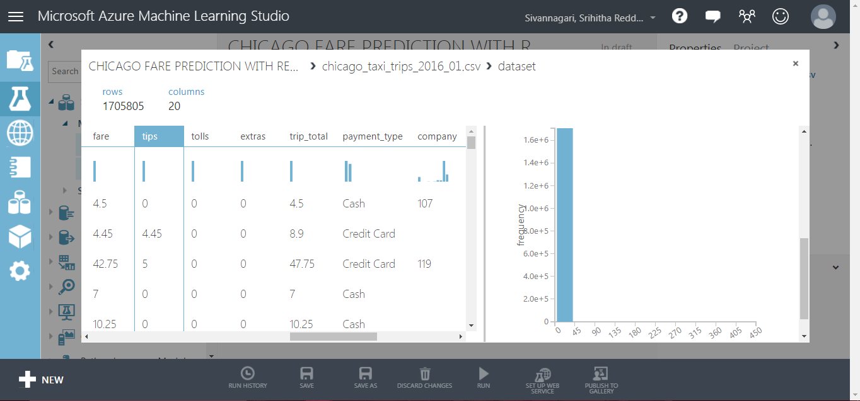

Slide 46
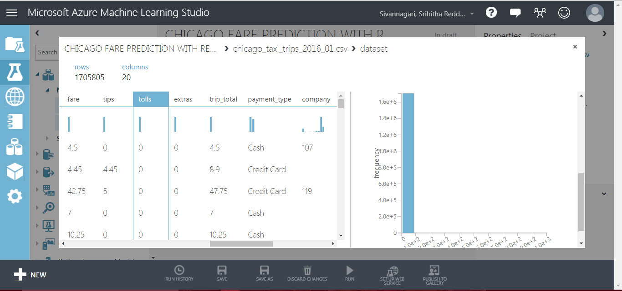

Slide 47
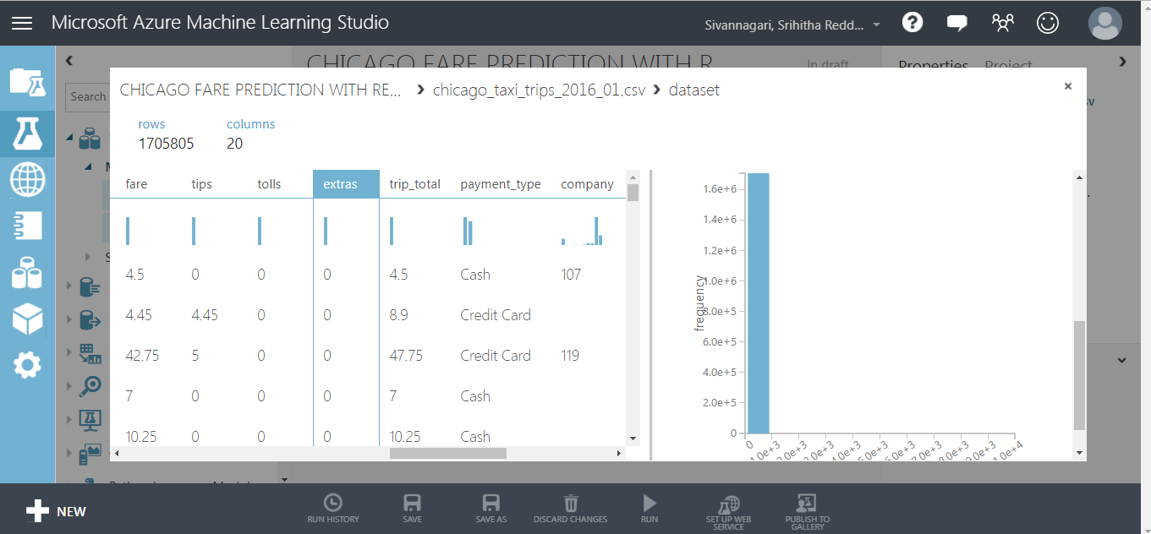

Slide 48
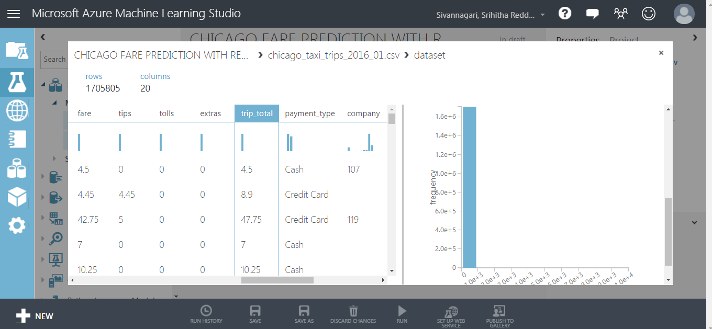

Slide 49
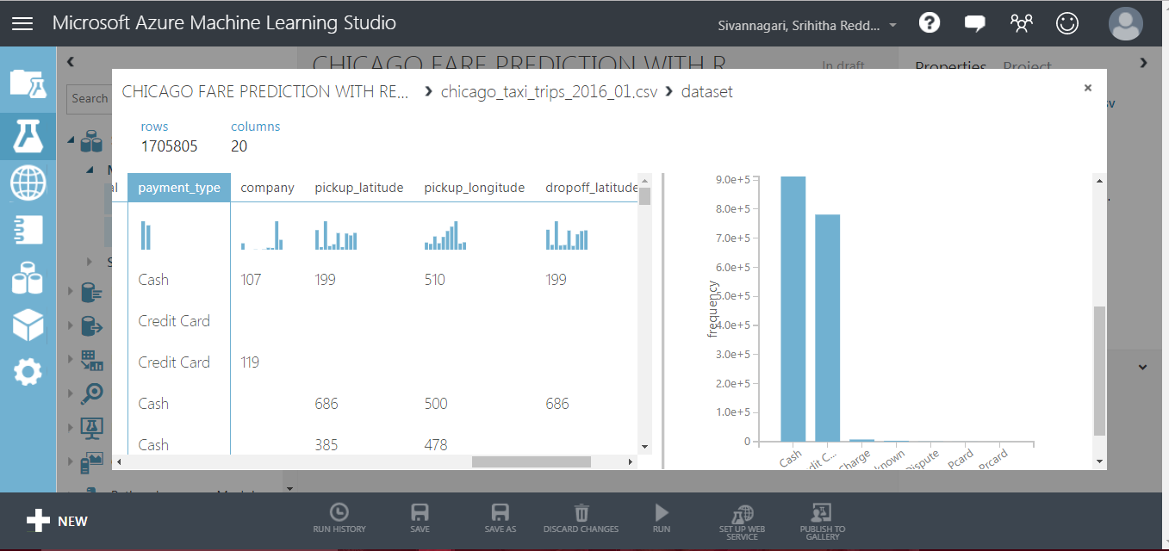

Slide 50
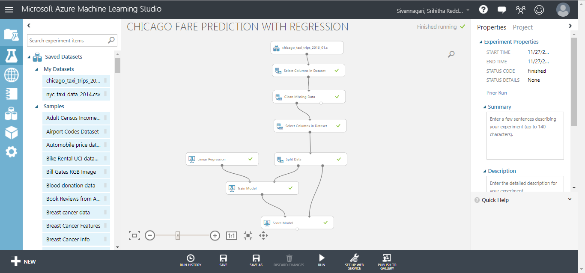

Slide 51
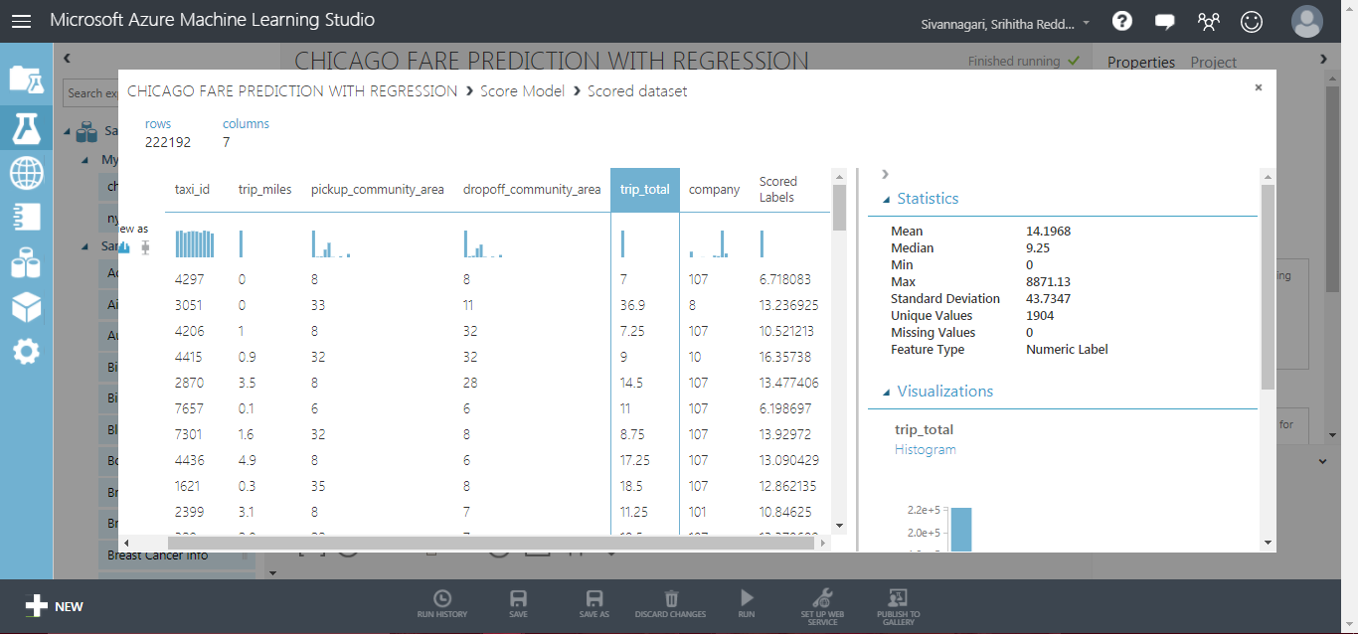
SCORED LABELS – TRIP_TOTAL

Slide 52
75% USED FOR TRAINING AND 25% USED FOR TESTING
SPLIT DATA

Slide 53
Conclusion
From the analysis we have carried out on the existing data and predictive analysis helped us understand that Chicago is a better city to start a business.

Slide 54
REFERENCES
https://docs.microsoft.com/en-us/azure/machine-learning/studio/create-experiment
https://www.qubole.com/resources/pig-function-cheat-sheet/
https://www.cloudera.com/documentation/enterprise/5-8-x/PDF/cloudera-hive.pdf
GitHub
https://github.com/srihithasreddy/cis5200-project

Slide 55
THANK YOU
QUESTION?

